Slide 1

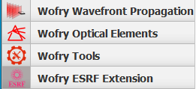
Introduction to WOFRY
Transport of coherence in a Beamline
Manuel Sanchez del Rio
srio@esrf.eu
Advanced Analysis & Precision Unit, MEG/ISDD, ESRF
WOFRY

Slide 2
Transport of coherence in a Beamline
Outline:
What is WOFRY
Basics of Partial Coherence in SR
Introduction to Coherent Mode Decomposition with 2D and 1D wavefronts
Examples
Gallery of results

Slide 3
WOFRY Wave Optics FRamwork in pYthon
WOFRY is the OASYS framework for waveoptics calculations.
From the software engineering point of view, it provides a generalization (or abstraction) of a software tool for wave optics, combining the component definitions from SYNED with the abstract declaration of wavefronts and propagators https://doi.org/10.1117/12.2274232, and defines a mechanism for interfacing a wave optics codes (e.g., SRW, WISE etc.) in OASYS [package: WOFRY]
From the physics point of view, it provides native implementations of simple wavefronts (e.g., plane waves, spherical waves, Gaussian sources), makes 1D coherent mode decomposition, and include free space propagators and optical elements for prototyping optical systems (in 1D and 2D). [package: WOFRYIMPL]

Slide 4
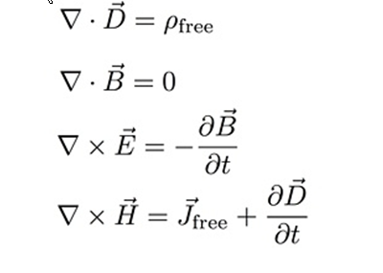
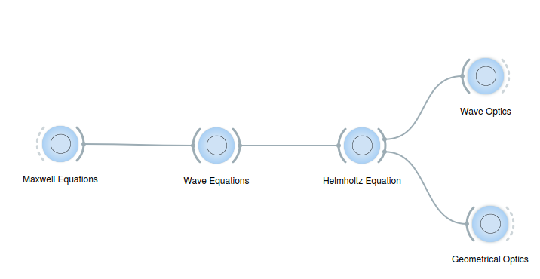
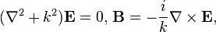
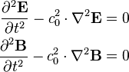
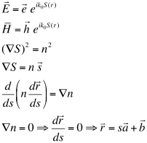
From theory to software: ALL ABOUT LIGHT
Wavefront
FULLY COHERENT:
A WAVEFRONT IS ALWAYS COHERENT
Rays
FULLY INCOHERENT:
A RAY IS A PLANE WAVEFRONT
THE RAYS DO NOT INTERFERE

Slide 5
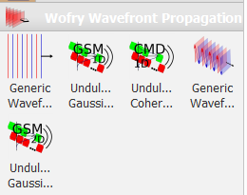
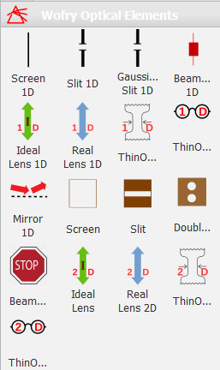
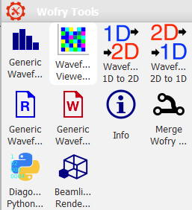
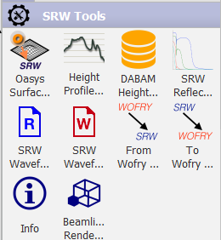
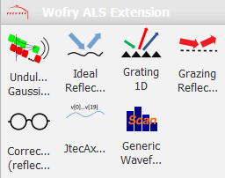
WOFRY
Sources Optical elements Tools

Slide 6
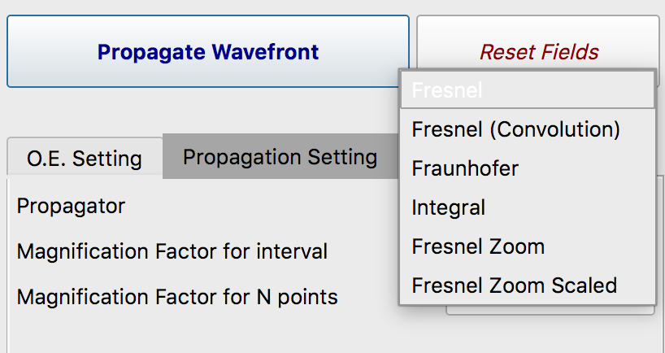
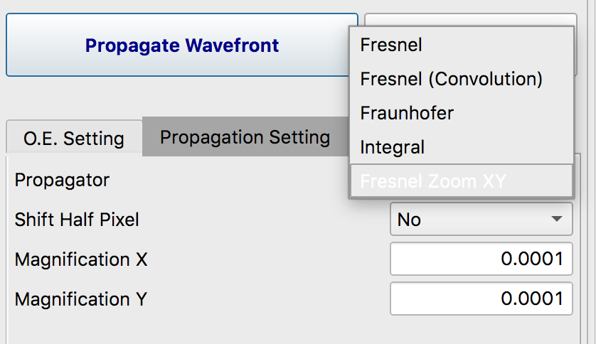
Propagators
Fresnel
Fresnel (convolution)
Fraunhoffer
Integral
Fresnel Zoom
Fresnel Zoom Scaled
1D
Fresnel
Fresnel (convolution)
Fraunhoffer
Integral
Fresnel Zoom XY
2D

Slide 7
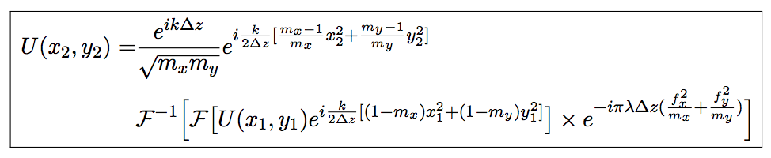
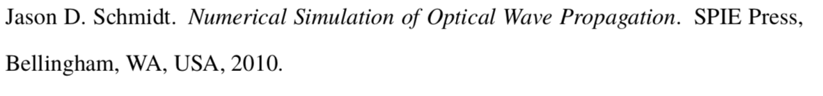
Zoom Propagator
G. Pirro, Master Thesis (2017)
https://github.com/oasys-kit/documents/blob/master/zoom_propagator_pirro_thesis.pdf

Slide 8
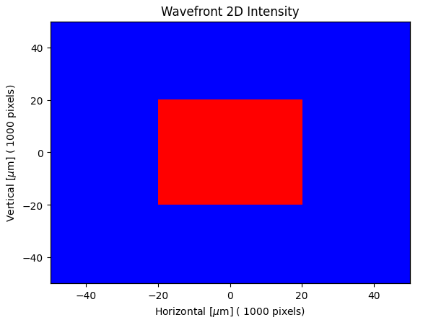
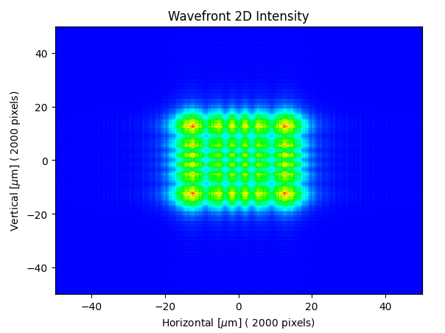
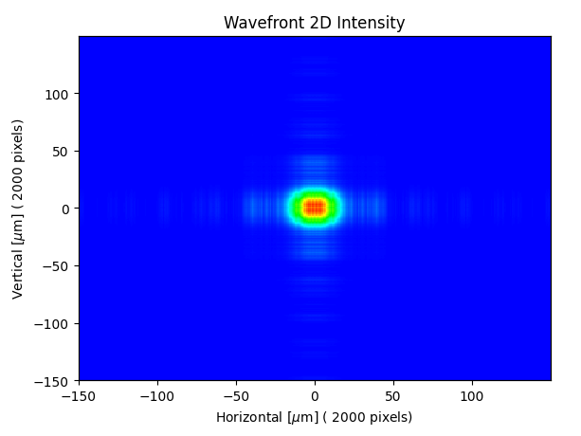
Coherence – Basic concepts
Ray tracing
1 m
15 m
MODEL 1
Coherence: is the ability of a beam to be diffracted by objects (e.g. slits) producing a “diffraction pattern”
Diffraction pattern results from the interference of propagated electric fields

Slide 9
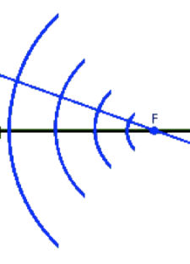
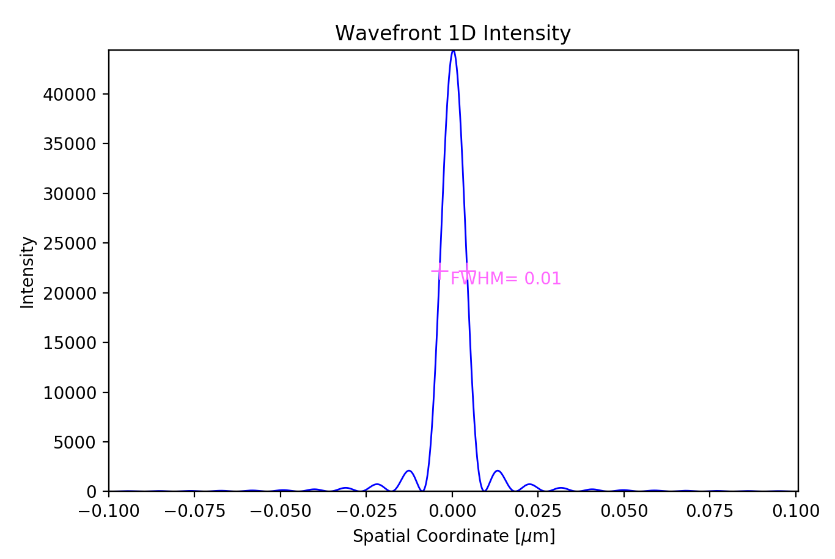
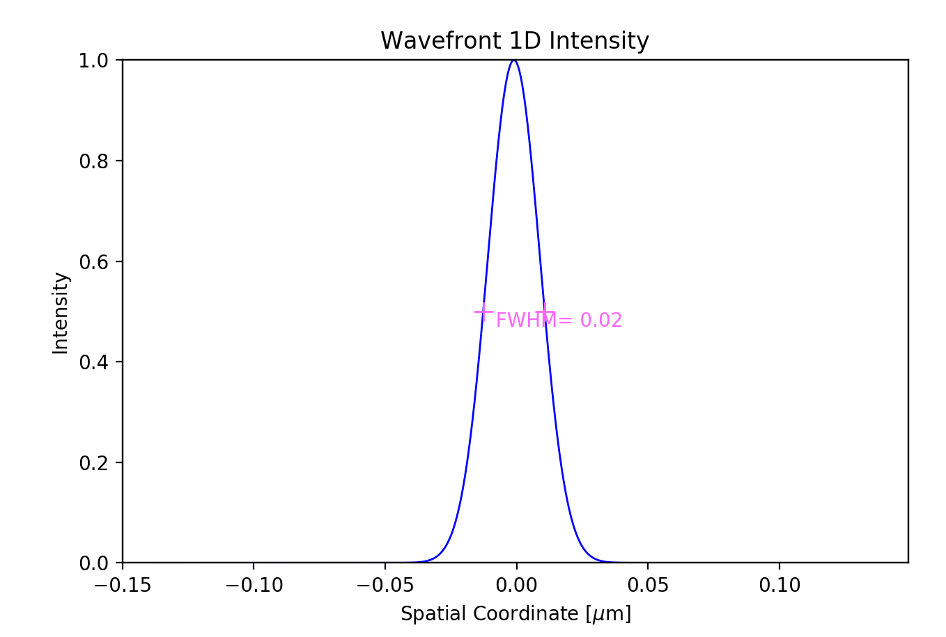

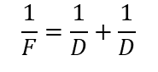
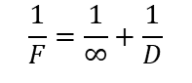
Diffraction by slits (fully coherence)
Aperture=0.4 mm, Ε=17225 eV, D=5cm
MODEL 2.1
Converging spherical +
Propagation (D)
MODEL 2.2
Plane + Lens (F=D)+ Propagation (D)
$$\frac{1}{F}=\frac{1}{∞}+\frac{1}{D}$$
F=D
MODEL 2.3
$$\frac{1}{F}=\frac{1}{D}+\frac{1}{D}$$
Spherical divergent+ Lens (F=D/2)+ Propagation (D)
F=D/2
MODEL 2.4
Gaussian+ Propagation(D)+ Lens (F=D/2)+ Propagation (D)
F=D/2

Slide 10
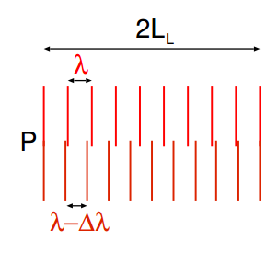
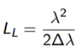
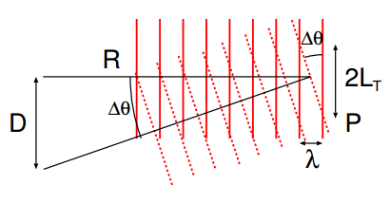
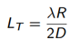
Coherence – Longitudinal and transversal
We need at least TWO waves for defining coherence parameters
Longitudinal or Temporal Coherence: depends on the monochromaticity of the source (describes the correlation or predictable relationship between waves observed at different moments in time)
Transversal Coherence: Depends on the source geometry (correlation between waves at different points in space)

Slide 11
The electron emission implies partial coherence
1 electron => Trajectory => Wavefront
Many identical electrons [filament beam] => Wavefront
Many non-identical electrons: multiple wavefronts

Slide 12
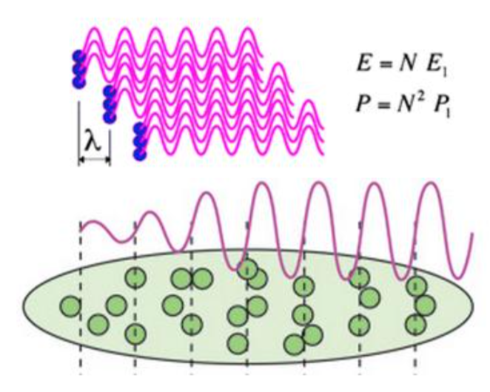
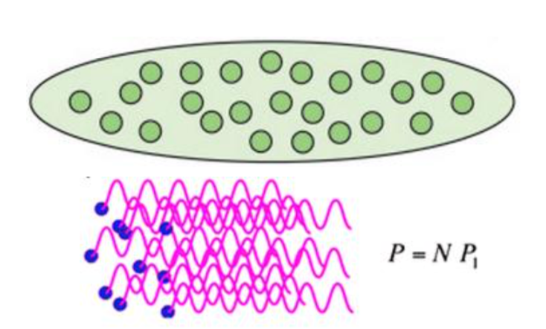
4th generation synchrotron sources
X-FEL
Bunch length ~ wavelength emitted so emission from different electrons add coherently – transversal (spatial) and longitudinal (time) coherence
Storage Ring
Bunch length >> wavelength so emission from electrons add incoherently.
Reduce the emittance from 3rd generation with the aim of becoming “diffraction limit” sources, i.e., natural emission << electron size. DLSR? Better ultra low emittance SR

Slide 13
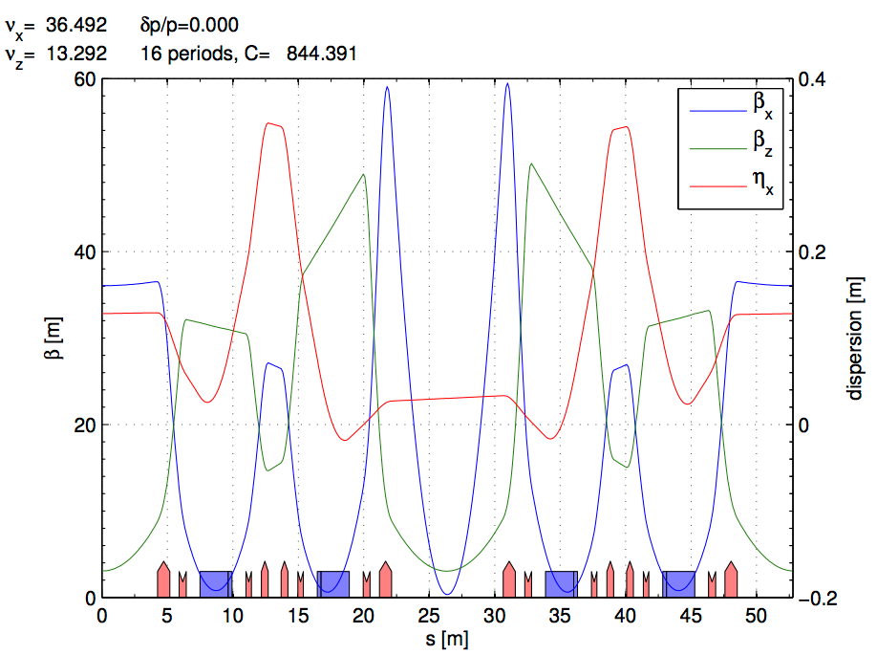
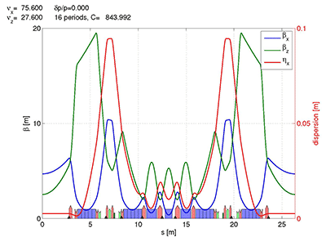
ESRF and EBS LATTICES
ESRF Double Bend Achromat (ESRF-1) -> Multi-bend achromat (EBS)
Horizontal emittance = 4000 pm Horizontal emittance = 137 pm
High Beta:
β_{x} = 37.59 m
β_{y} = 2.95 m
σ_{x} = 415.0 μm
σ_{y} = 3.43 μm
σ_{x’}= 10.3 μrad
σ_{z’}=1.16 μrad
Low Beta:
β_{x} = 0.35 m
β_{y} = 3.0 m
σ_{x} = 50.4 μm
σ_{y} = 3.44 μm
σ_{x’}= 107.2 μrad
σ_{z’}=1.16 μrad
EBS (S28D):
β_{x} = 6.90 m
β_{y} = 2.64 m
σ_{x} = 30.2 μm
σ_{y} = 3.64 μm
σ_{x’}= 4.37 μrad
σ_{z’}=1.37 μrad

Slide 14
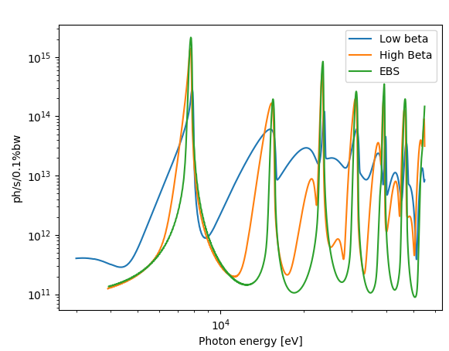
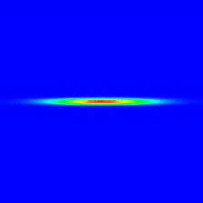
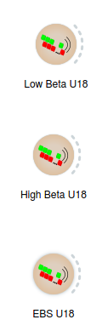
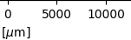
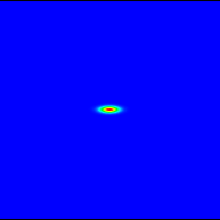
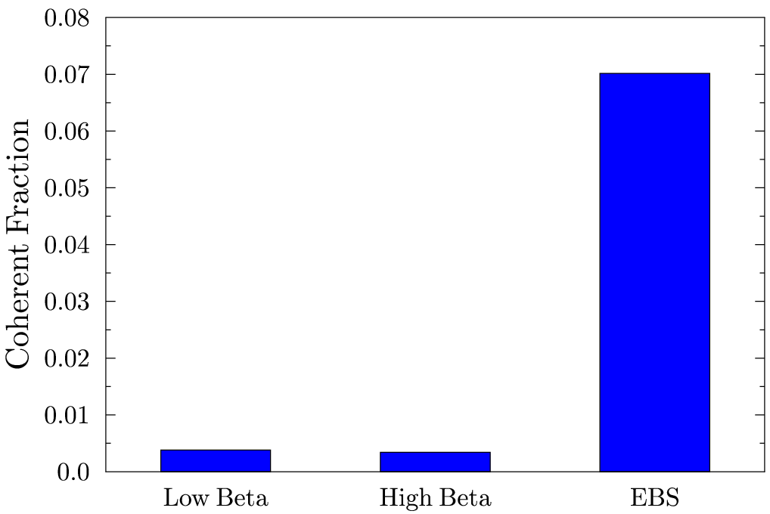
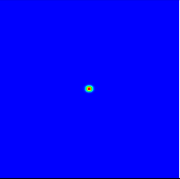
EBS – ESRF U18 2m @ 8 keV L=2m observed at 30m
Big increase of brightness and transverse coherence

Slide 15
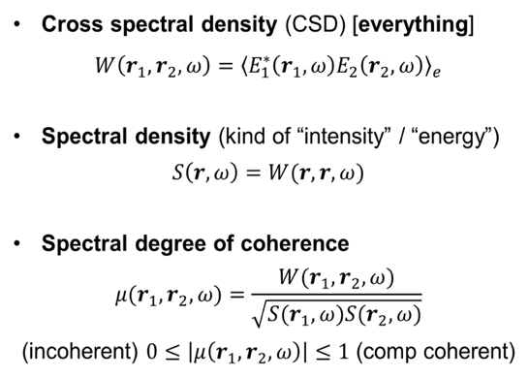
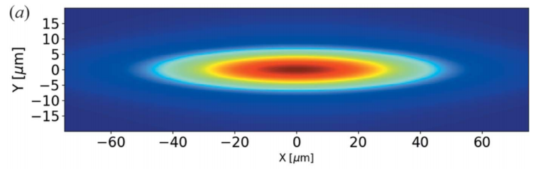
All we need is Cross Spectral Density
Coherent length
Can be defined
from some cuts

Slide 16
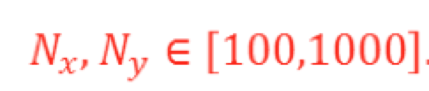
Coherent Mode Decomposition
10D function (3x3+1)
Fix E and z => 4D
Still W too big to calculate/store
W ~ 10⁸ – 10¹² (Gb-Tb)
Eigenvalues:
Weights or intensities
Eigenfunctions:
Modes
4D function
2D functions
Store: m x N x N; Propagate: 2D integrals
M Glass, M Sanchez del Rio, EPL Europhysics letters (2017)
http://dx.doi.org/10.1209/0295-5075/119/34004

Slide 17
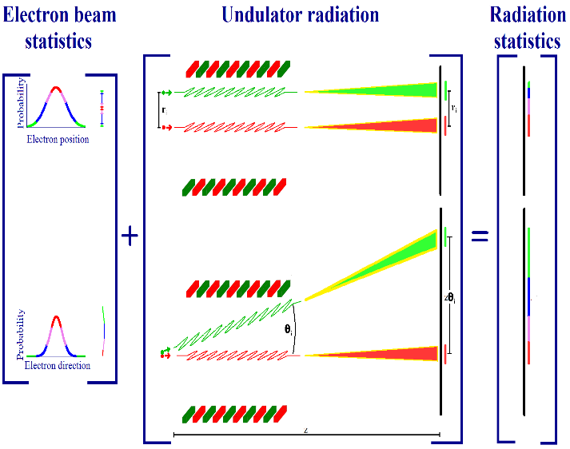
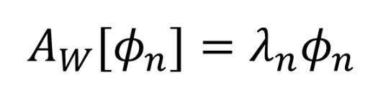
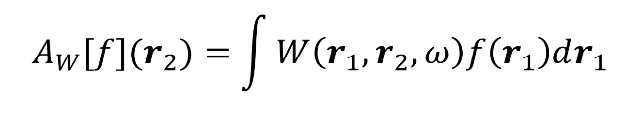
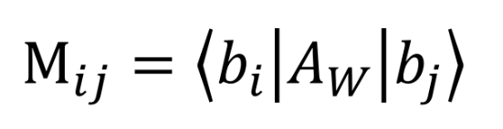
COMSYL (Coherent Modes for Synchrotron Light)
COMSYL https://github.com/mark-glass/comsyl
Calculate CSD
Coherent mode decomposition
K.-J. Kim Proc. SPIE 0582 (1986)
OASYS
Friedholm equation:
Propagate CSD along the beamline
Diagonalize M with iterative solver slepc
Large memory.
Parallel computers using MPI.
Large clusters (ESRF). Cloud computing (AWS, etc.)
Rediagonalize CSD

Slide 18
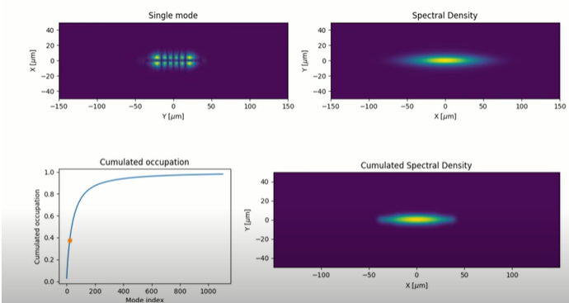
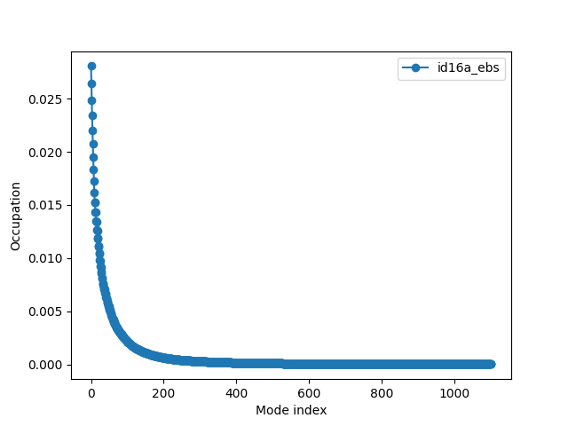
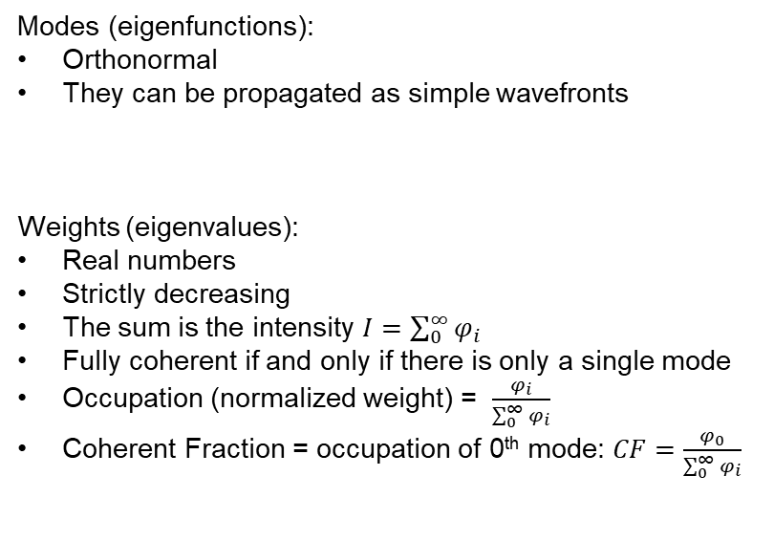
Benefits of Coherent Mode Decomposition
Modes (eigenfunctions):
Orthonormal
They can be propagated as simple wavefronts
Weights (eigenvalues):
Real numbers
Strictly decreasing
The sum is the intensity $I=\sum_{0}^{∞}{φ_{i}}$
Fully coherent if and only if there is only a single mode
Occupation (normalized weight) = $\frac{φ_{i}}{\sum_{0}^{∞}{φ_{i}}}$
Coherent Fraction = occupation of 0th mode: $CF=\frac{φ_{0}}{\sum_{0}^{∞}{φ_{i}}}$
https://youtu.be/h24RrJZaQ80
Coherent Fraction
EBS 2.8%
ESRF-EBS (17 keV)

Slide 19
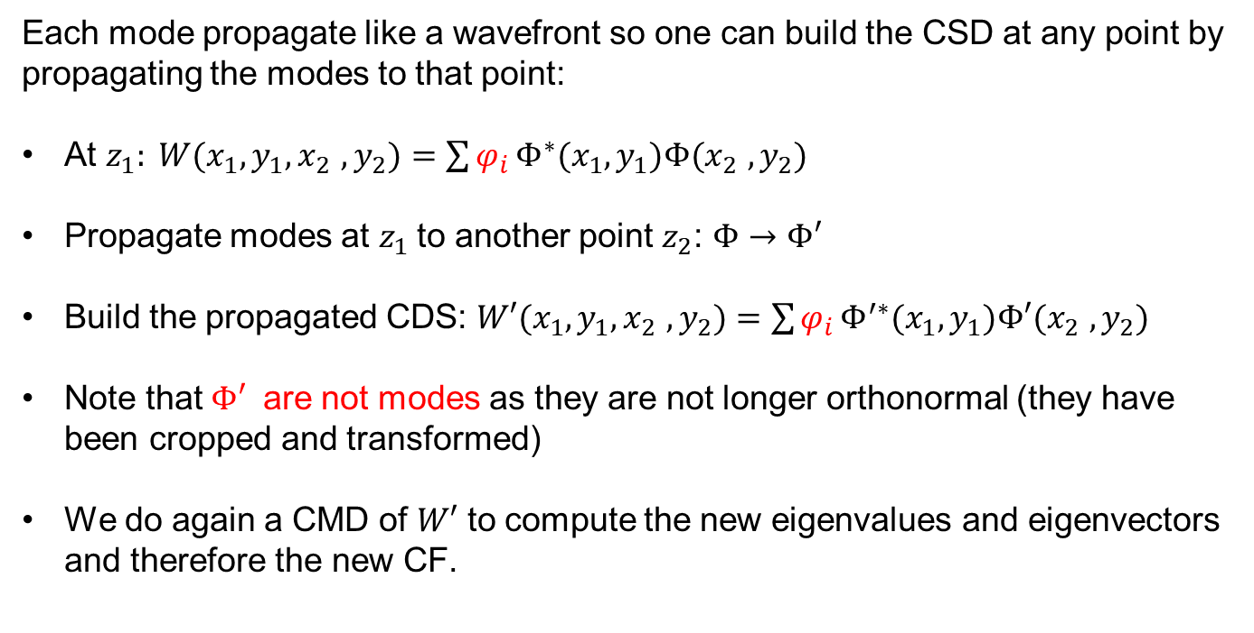
Important: A mode propagated is not longer a mode
Each mode propagate like a wavefront so one can build the CSD at any point by propagating the modes to that point:
At $z_{1}: W(x_{1},y_{1},x_{2}$ $,y_{2})=\sum{φ_{i}}Φ^{∗}(x_{1},y_{1})Φ(x_{2} ,y_{2})$
Propagate modes at $z_{1}$to another point $z_{2}$: $Φ→Φ′$
Build the propagated CDS: $W′(x_{1},y_{1},x_{2}$ $,y_{2})=\sum{φ_{i}}Φ^{′∗}(x_{1},y_{1})Φ′(x_{2} ,y_{2})$
Note that $Φ′$ are not modes as they are not longer orthonormal (they have been cropped and transformed)
We do again a CMD of $W′$ to compute the new eigenvalues and eigenvectors and therefore the new CF.

Slide 20
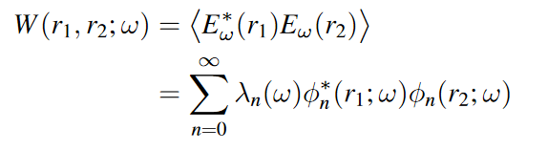
Coherent Fraction (partial coherence)
CF: Ratio of the good photons (coherent) over the total amount of photons
CF=1 for a coherent source and 0 for an incoherent one
Beams are treated with:
“wave optics” if they are coherent
“ray tracing” if they are incoherent
“coherent mode decomposition”¹ if they are partially coherent
The CF can be calculated:
From the ratio of the phase space: “coherent source” / “actual source”
Occupation of the first coherent mode
Consequences:
Storage ring with zero emittance has CF=1 (Diffraction Limited Storage Ring)
Small emittance implies better coherence
CF decreases when photon energy increases
It was CF~10⁻³, 10⁻⁴ for ESRF1 and CF~10⁻² FOR EBS

Slide 21



Everything is much simpler in 1D:
Horizontal W(x₁,x₂) Vertical W(y₁, y₂)
CMD WITH WOFRY (EBS U18 2.5m 7 kev)
A fast and lightweight tool for partially coherent beamline simulations in fourth-generation
storage rings based on coherent mode decomposition. J. Synchrotron Rad. 29, 1354–1367 (2022)
Sanchez del Rio, M., Celestre, R., Reyes-Herrera, J., Brumund, P. & Cammarata, M..
DOI: http://dx.doi.org/10.1107/S1600577522008736

Slide 22


Benchmarking (7 keV)

Slide 23


Benchmarking (7 keV)

Slide 24

Benchmarking (7 keV)

Slide 25








Example: Gain coherence by using a slit ESRF U17 @ 15 keV
MODEL 3
Modes Cumulated occupation
CFh=0.53
CFh=0.07
Horizontal
50x50 μm²
Vertical
Modes Cumulated occupation
CF= CFh x CFv:
Source: 0.038
Image: 0.51
CFv=0.97
CFv=0.54

Slide 26


Example: U17 @ 15 keV Coherence gain by closing slit

Slide 27


2D Oversimplified Beamline (APS-ISN)
Theoretical consideration
The diffraction by a DxD square aperture of a collapsing spherical wavefront has an intensity distribution proportional to sinc²(kDx/2f ) sinc²(kDy/2f), where k=2π/λ, x(y) is the horizontal (vertical) coordinate, and f is the distance aperture-focus (D/f is the divergence). Considering that the FWHM of sinc²(x) is approximately 2.78, one obtains FWHM=0.885 * wavelength / divergence
Size FHHM 0.0148872 x 0.016168 um

Slide 28

1D model of ISN Beamline (25 keV)
CF: 14%
14 μm
CF: 38%
CF: 82%
CF: 99%
CF: 52%
4 μm
CF: 90%

Slide 29
Gallery of results

Slide 30


EBS vs ESRF1 : Coherence fraction with COMSYL
M Glass, M Sanchez del Rio, EPL Europhysics letters (2017)
http://dx.doi.org/10.1209/0295-5075/119/34004

Slide 31

COHERENCE FRACTION MODIFICATION BY SLITS
EBS U18 L=2.5m
58% (V)
13% (H)
Sanchez del Rio, M., Celestre, R., Reyes-Herrera, J., Brumund, P. & Cammarata, M..
J. Synchrotron Rad. 29, 1354–1367 (2022)
DOI: http://dx.doi.org/10.1107/S1600577522008736

Slide 32










ALS-FLEXON: CORRECTION OF THERMAL DEFORMATION WITH ADAPTIVE OPTICS
M1: 819μm
M3: 1630 μm
Sample: 3.8 μm
LN cooling Cutler et al. http://dx.doi.org/10.1107/S1600577520009522)
Water cooling
(CF ~ 0.8 with a 4 m undulator at 230 eV)
M. Sanchez del Rio et al, JSR 2020
http://dx.doi.org/10.1107/S1600577520009522

Slide 33














ALS-U U38 source 806 eV (COMSYL CMD)
m=19 (ice crystal)
m=32 (mask)
m=43 (clock)
m=0
m=0
m=1
m=2
m=3
m=4
m=5
m=6
m=7
m=8
m=9

Slide 34




Lens shape for perfect geometrical focusing
Aspherical lens shapes for focusing synchrotron beams
M. Sanchez del Rio and L. Alianelli (2012)
https://doi.org/10.1107/S0909049512003020

Slide 35

Beam focus modifications by cropping partially coherent X-ray beams
p₀
p₁
Sanchez del Rio, M., Celestre, R., Reyes-Herrera, J., Brumund, P. & Cammarata, M.
EPL 140 55001 (2022) DOI https://doi/org/10.1209/0295-5075/aca4ef

Slide 36


X-ray lens aberrations retrieved by deep learning from several beam intensity images https://doi.org/10.1107/S1600577524004958
Get wawefront errors (and optical surface errors)
Optics
Source
Focusing lens with optical surface errors
Typically: dedicated phase retrieval experiment
Speckle tracking
Ptychography, etc.
Undulator Partially Coherent Source at EBS
+
Can we get the optical surface errors with (several) images (only intensity) using directly the EBS source?
Our approach is:
Sensorless: we do not use a dedicated experiment to measure phase (only intensities)
Blind: it requires as an input only the blurry images, and not a point spread function that we may have obtained using other means such as a calibration step. This is only possible when the source is good, like EBS.

Slide 37

Implementation: 1D wavefronts
Produce synthetic data with many runs in a reasonable computing time:
Reduced data volume
Include partial coherence
Error profile samples are by created
defining a set of Zernike coefficients with random values. In our case, using Noll notation, we consider the first 15 polynomials excluding the four first ones (piston, tip, tip and defocus) but adding the secondary and tertian spherical aberrations (Noll numbers 22 and 37). In our case, for 1D simulations in the vertical plane, we are not interested in those with azimuthal dependency, thus ending with 7 polynomials [6, 8, 10, 11, 14, 22, 37].
For each one, a random coefficient should be created. Instead of applying uniform sampling for all of them in the same interval (as done in (Saha et al., 2020)), we prefer to customize the ranges and distributions for using empirical experience. We thus sample coefficients using the distributions [n, n, n, u, n, u, u] (n=normal,u=uniform) and intervals [σ=0.5, σ=0.5, σ=0.5, ±2.3, σ=0.05,±1.0, ±0.5] ×F microns, with a factor F = 5.
We sampled NS 2D mesh surfaces and write the vertical profile in a file, to be used in our wavefront simulations.
Problem: our base is not orthonormal.
We orthogonalized our base of 1D cuts of Zernike polynomials using the Gram-Schmidt method, to obtain a new orthonormal 1D basis, and therefore new weights [coefficients] of the random profile.
These new Gram-Schmidt coefficients are used in the learning process. (This does not change the error profiles used in the wavefront simulations, but changes the target values uses to train and test the CNN)

Slide 38

Creation of training data
NA
propagation
…
NS “error profiles” (7 GS coeffs)
NS “images” (NA x NP)
- Simulate a stack of NA × NP × NS float number values, that constitute the data for the CNN.
NA: Number of points (pixels) in a profile (image). 1500 (calculated) interpolated to NA=256
NP: number of propagation planes (propagated profiles) NP=64
NS: number of runs (sampled profiles – sampled images)
Running the wavefront simulations for NS=5000
2h in a CPU using a single coherent mode
For partial coherence simulations we propagated 10 coherent modes that contain more than 99% of the total intensity, therefore it takes about 10 times more running time.
Note: Our simulations are not available in GPUs, therefore it cannot be created on-the-fly during training is run in GPUs.
The target data is a stack of NS × 7 values, containing the Gram-Schmidt coefficients

Slide 39

The CNN
7 GS coeffs
“error profiles”
1 2 3 4 5 D D D
We created a CNN using Keras with architecture similar to PHASENET (Saha et al., 2020). It consists of
five stacked blocks, each comprising two (3 × 3) convolutional layers (with stride 1 and the number of channels 8,16,32,64,128
one max-pooling layer (only along the lateral dimensions),
two dense layers (64 channels)
a final dense layer having the same number of neurons as the number of Gram-Schmidt coefficients to be predicted (7 in our case)
We use relu as activation function for all layers except the last, where we use linear activation. This results in a rather compact CNN model with a total of 430655 parameters.
To prevent overfitting, we look at the accuracy of the training and validation data (a 20% fraction) and verified a uniform parallel increasing accuracy on the training and validation sets. If needed, we rerun the training with increased NS. The possibility to increase more and more NS (i.e. having an ilimited number of samples) is the great advantage of using synthetic data for training the CNN, and makes not necessary the use of regularization techniques to avoid overfitting.
We minimize the mean squared error (MSE) between predicted and ground truth coefficients and train each model for NE epochs and batch size 64 on a GPU (NVIDIA Tesla V100-SXM2-32GB) using the RMSprop optimizer with learning rate 10−4 for a total training time of less than one hour.

Slide 40




The results (coherent source)
NS=1000
NS=5000

Slide 41


The results (partial coherence: 10 modes)
1500 epocs 24000 epocs

Slide 42
Effect of the number of images (NP) and their posiiton
Thinking about the possible experimental realization of the system discussed here, it is important to make economies in:
the number of images to be acquired (NP)
the scanning interval.
Ideally, the highest NP and the higher interval, the better.
This is also discussed in (Saha et al., 2020) showing that a reduction in the number of images is possible at the price of a less good learning and the minimum number of images is somehow related to the number of target coefficients in use.
We trained the CNN with less image planes by just picking the calculated data with frequency:
1 (NP = 64) [initial] an accuracy of 93%
2 (NP = 32) an accuracy of 85%
4 (NP = 16) an accuracy of 84%
What happens if we scan the image plane out of focus? We used the calculations on the 32 planes downstream from focus, and got good accuracy (92%) but with a much different learning curve with a step-down at about 700 epochs. Stopping the learning at this point, we obtained an accuracy of 90%, also showing that the system still works well.

Slide 43
Conclusions
a CNN trained with synthetic data is able to retrieve the profile error in an x-ray lens giving as input a set of intensity distributions measured or calculated at different positions
ML use is mature in wavefront sensing
Synthetic [simulated] data is a good inexpensive source of data for ML
Think in the volume of data to be generated and to be digested my the ML
Does the CNN trained with synthetic data work for experimental data?
Can we believe the ML results?
Can we quantify how good they are?
Can we get certification? Error bars?

Slide 44




Singularities in the phase of the cross spectral density
COMSYL 1.4-m-long U18 EBS (6 GeV, 147 pm rad emittance)
Eo = 17.226keV (K =0.411)
Intensity (spectral density)
First coherence mode
Fix a point
D Paganin, M Sanchez del Rio, Phys Rev A (2019)
http://dx.doi.org/10.1103/PhysRevA.100.043813

Slide 45

Propagated BEAM: DIFFERENT TYPES OF SINGULARITIES APPEAR
Domain walls
Coherence
vortices
a,b, g
Vortex-antivortex hi,jk
Halo of CSD speckle
D Paganin, M Sanchez del Rio, Phys Rev A (2019)
http://dx.doi.org/10.1103/PhysRevA.100.043813

Slide 46
Thank you!

Slide 47
Extra slides

Slide 48




SIMPLE CASE: 1D Gaussian SHELL-MODEL
Both intensity (Spectral Density) and correlation (Spectral Degree of Coherence) are Gaussians
σ_{I}>>σ_{μ} the source is mostly incoherent (quasi homogeneous)
σ_{I}<<σ_{μ} is mostly coherent
I
I
Eigenvalues
Eigenfunctions
(Hermite-Gaussian modes)
Magic property: Propagation invariance
In the first mode (Gaussian) :
In 2D (H x V)
2D Hermite-Gaussian or
TEM_{nm} modes

Slide 49






The spectrum of coherent modes
Eigenvalues
Mode occupation:
Coherent: β>>
Coherent fraction:
incoherent
β<<
In general we cannot apply Gaussian Shell-model to synchrotron

Slide 50
Coherence – Longitudinal and transversal
We need at least TWO waves for defining coherence parameters
Longitudinal or Temporal Coherence: depends on the monochromaticity of the source (describes the correlation or predictable relationship between waves observed at different moments in time)
Transversal Coherence: Depends on the source geometry (correlation between waves at different points in space)

